Slide 1
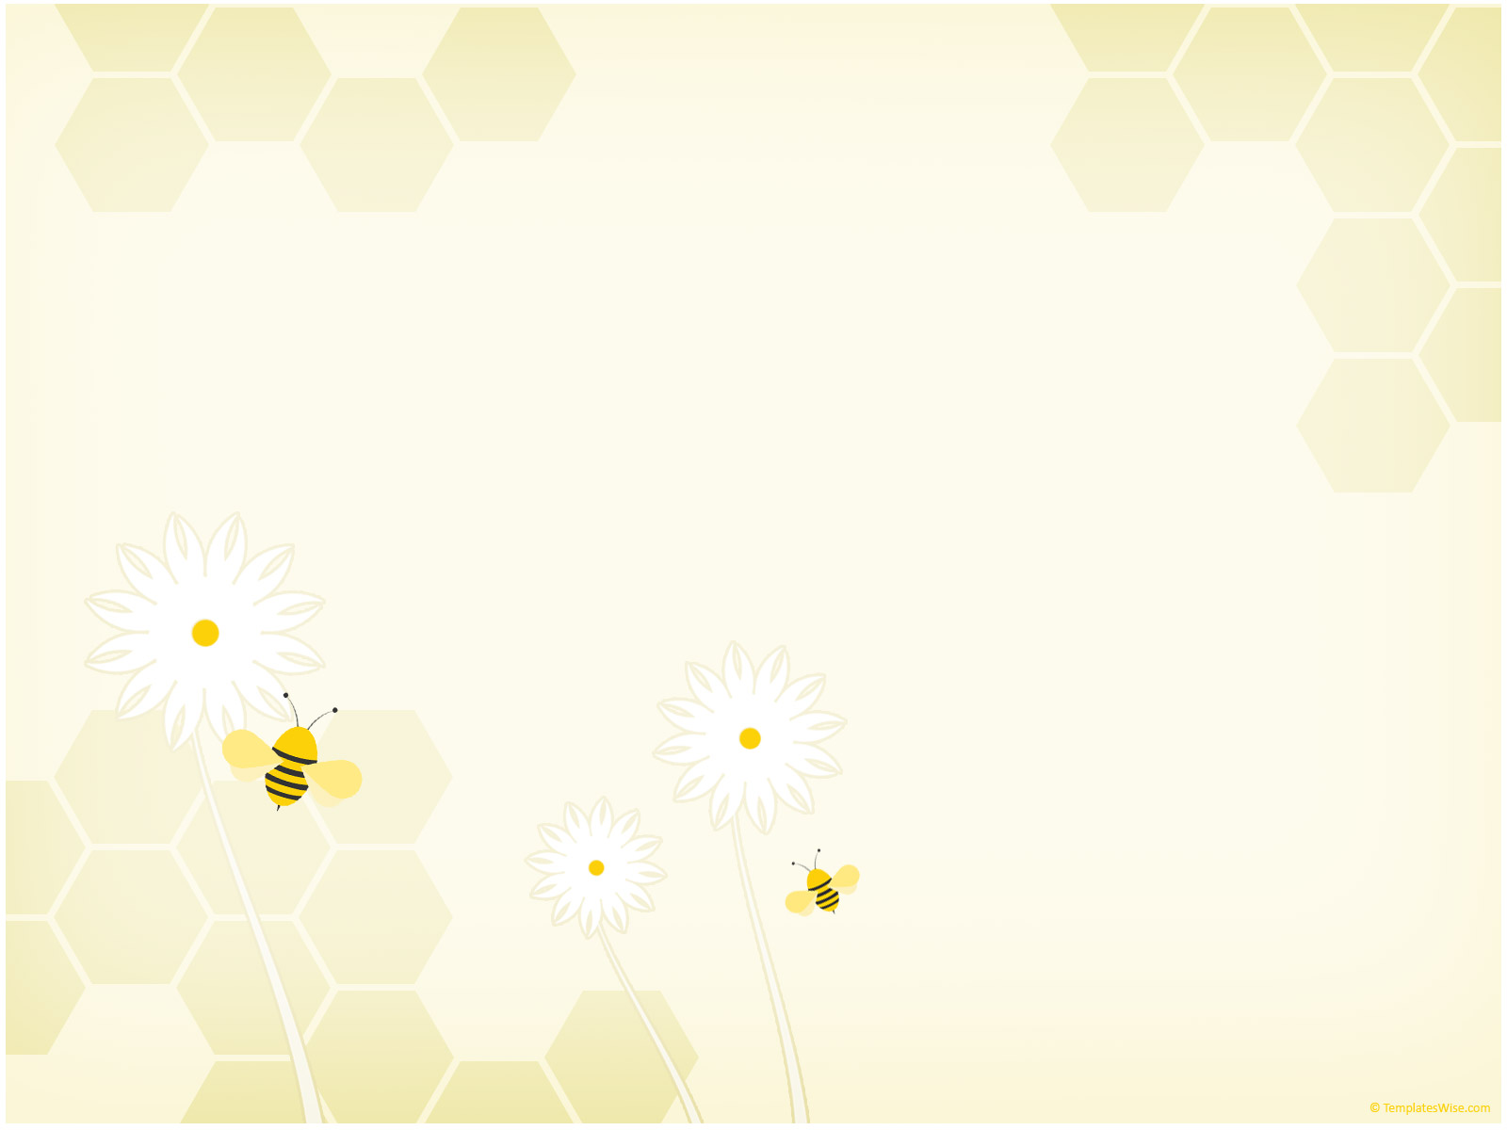
Bee Project
A community created work of art
*This version does not include embedded video, please make sure you have an active internet connection to view videos.

Slide 2

Nature Creek Intro Video

Slide 3
Project Intro Video

Slide 4

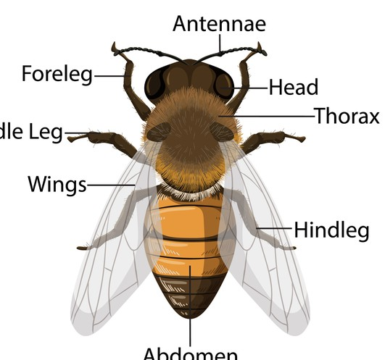
Anatomy (parts) of a bee
Antenna
Front Leg
Head
Body
Middle Leg
Wings
Back Leg
Abdomen

Slide 5
What shapes do you see?
Antenna
Front Leg
Head
Body
Middle Leg
Wings
Back Leg
Abdomen

Slide 6
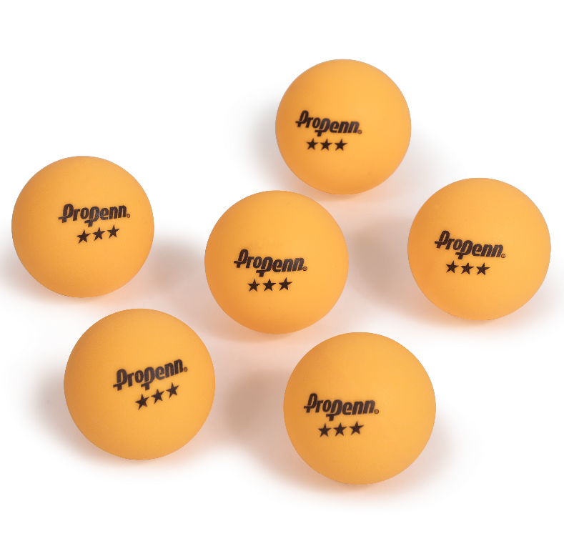
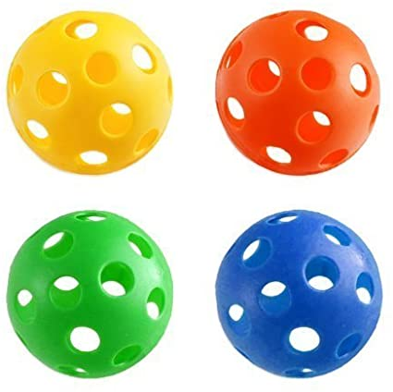
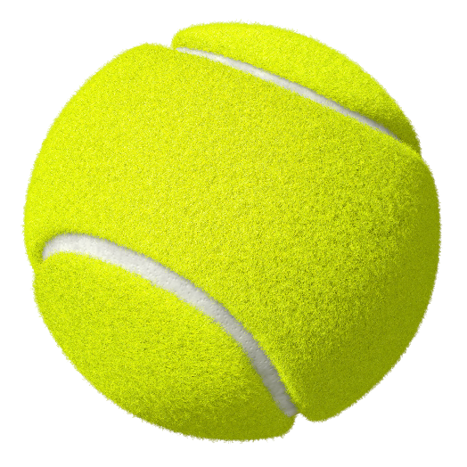
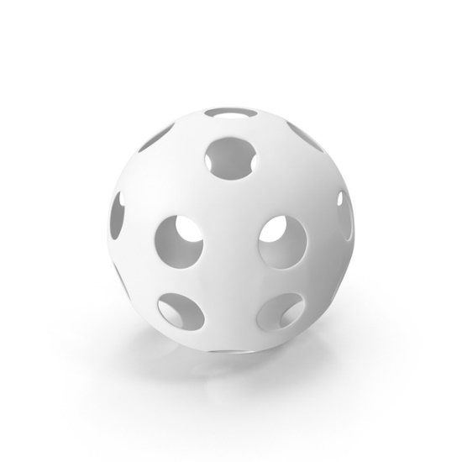
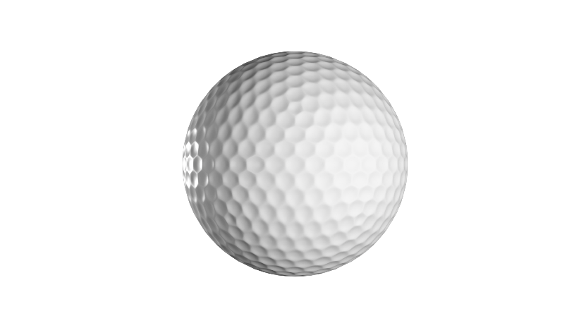
How can we make a head?
What objects are spheres?

Slide 7
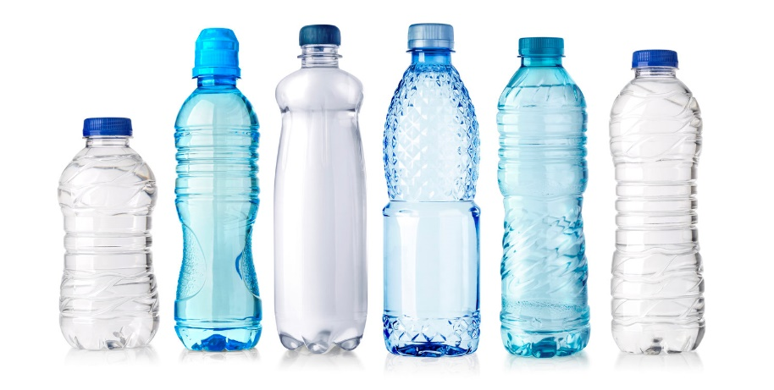
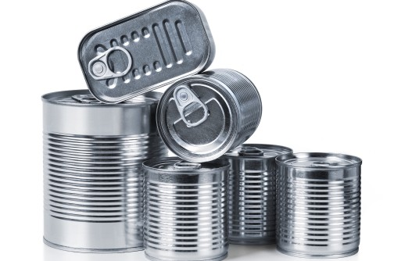
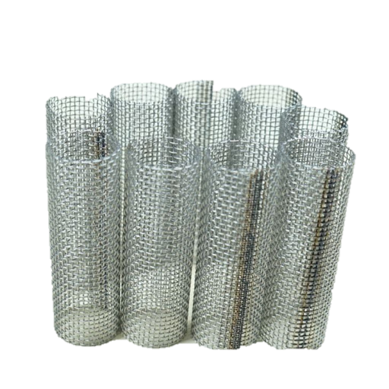
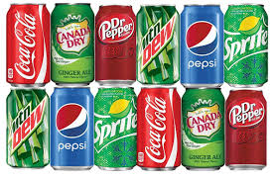
What cylinder can make the abdomen or body?
What objects are spheres?

Slide 8
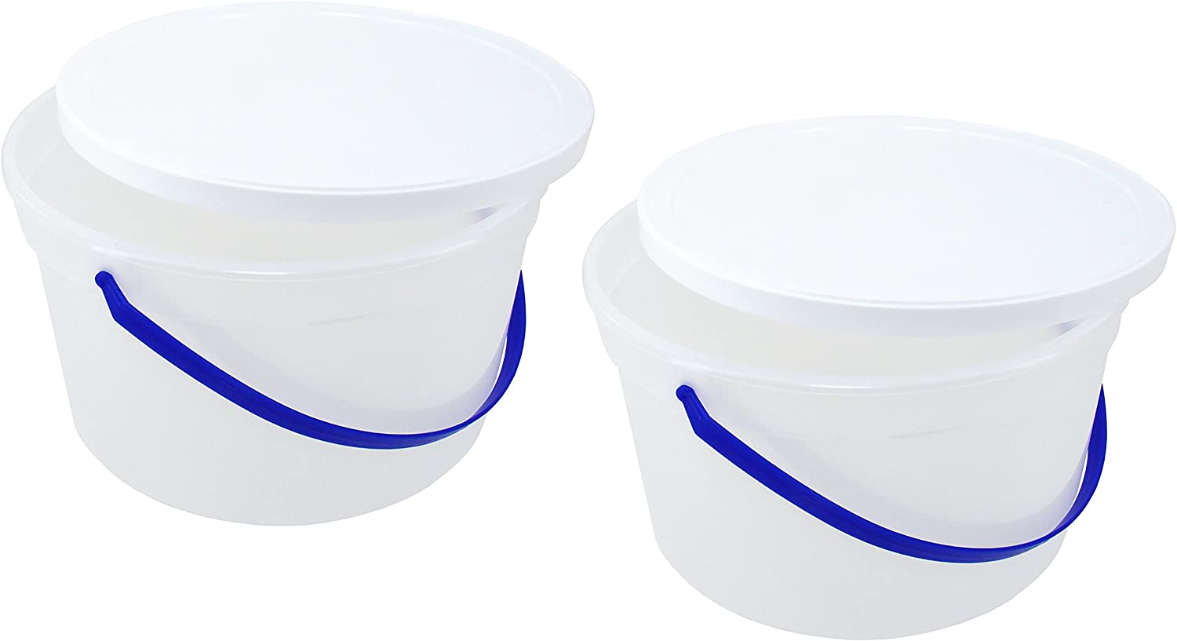
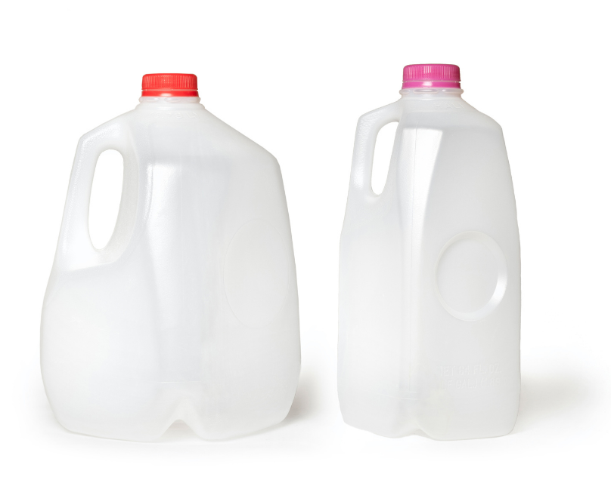
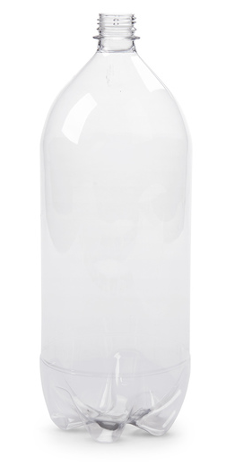
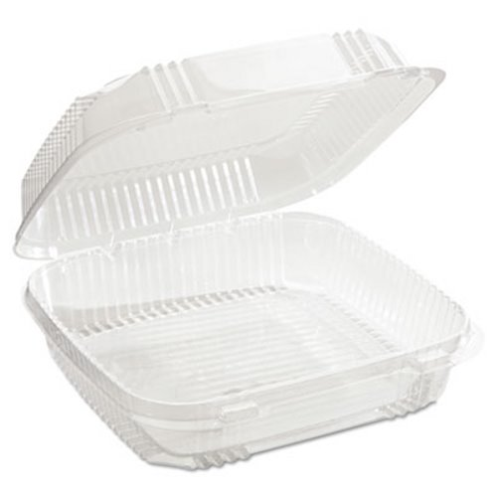
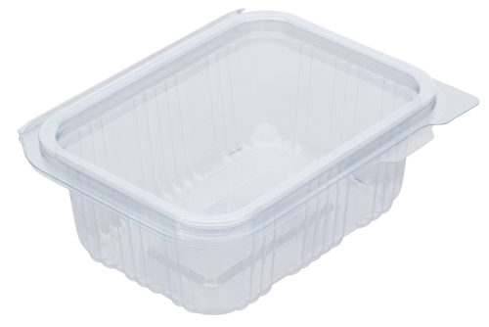
What can you cut wings out of?

Slide 9
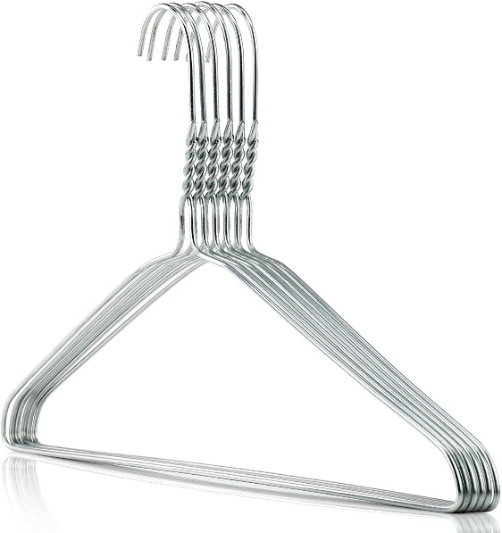
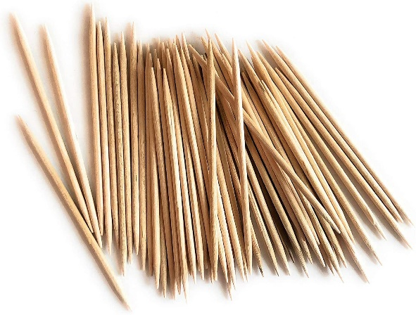
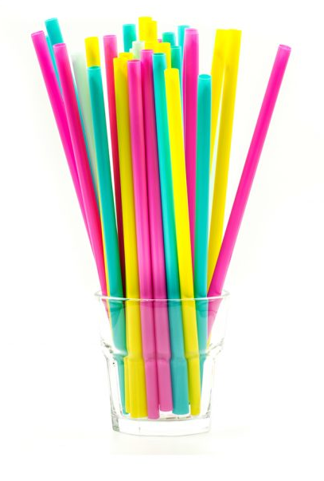
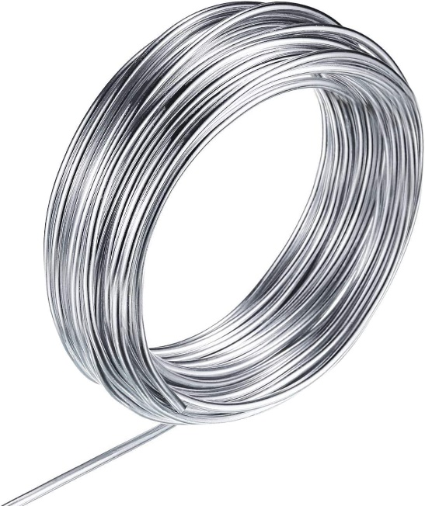
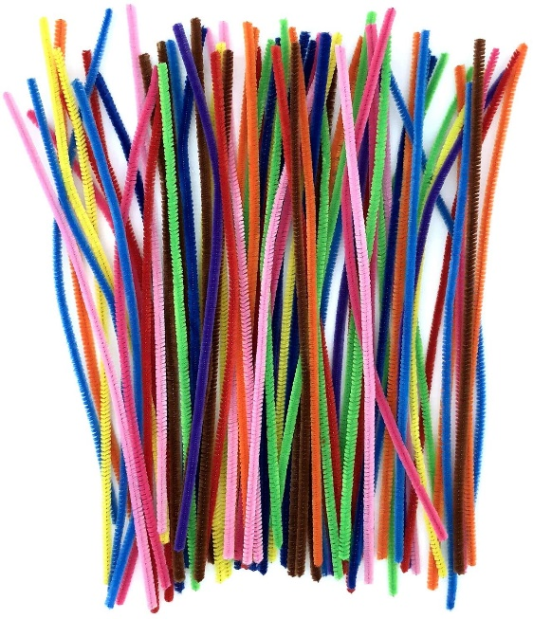
What about the legs, antennae, and stinger?

Slide 10
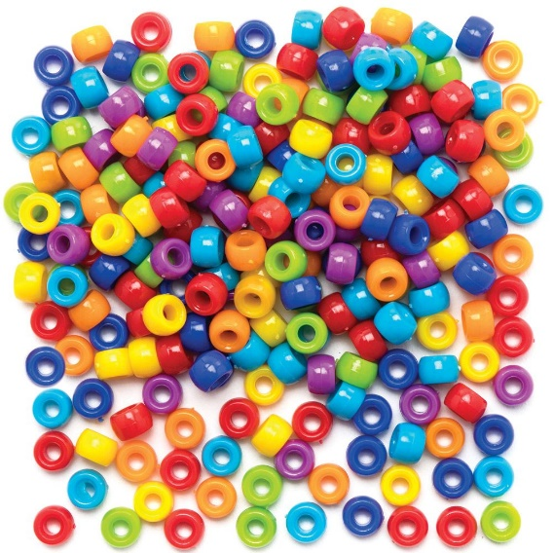
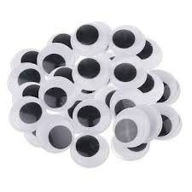
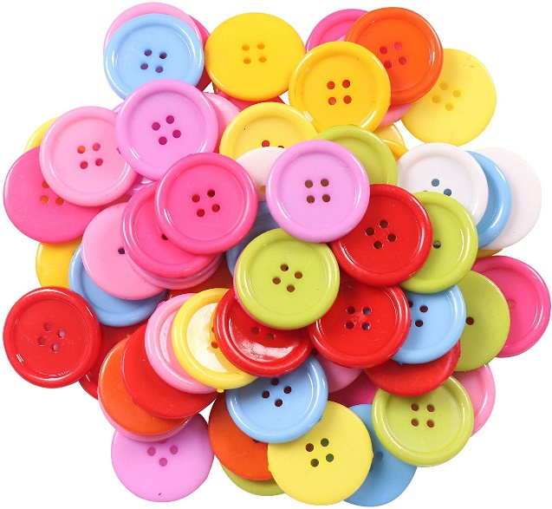
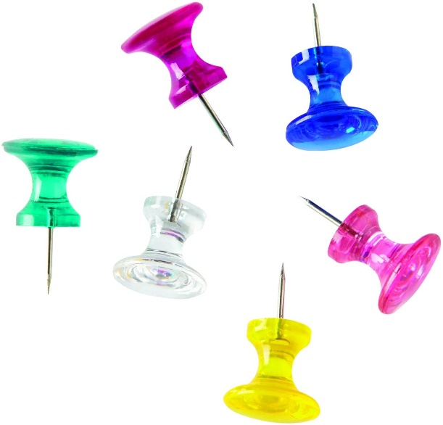
What about the eyes?

Slide 11
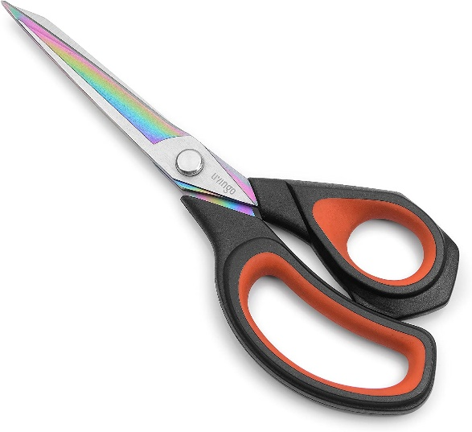
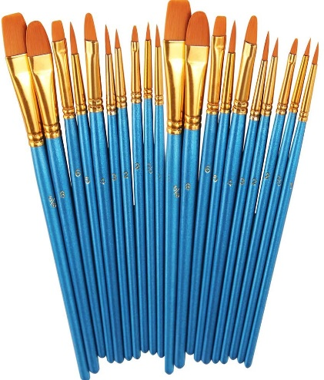
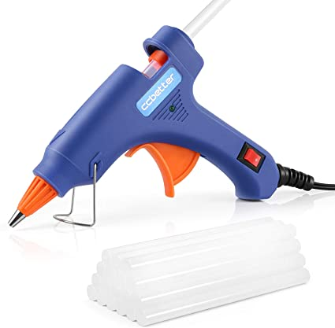
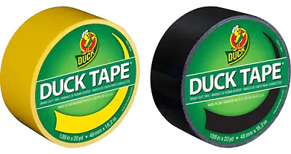
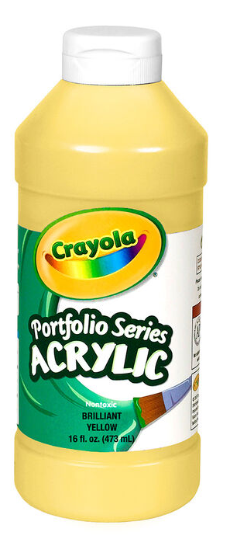
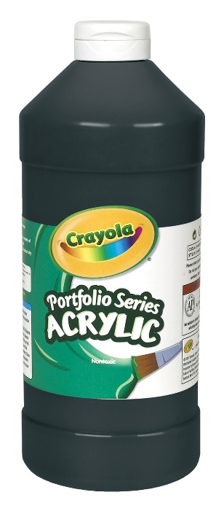
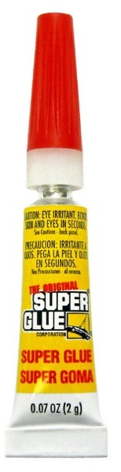
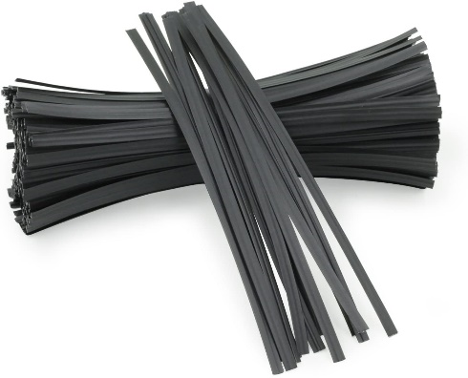
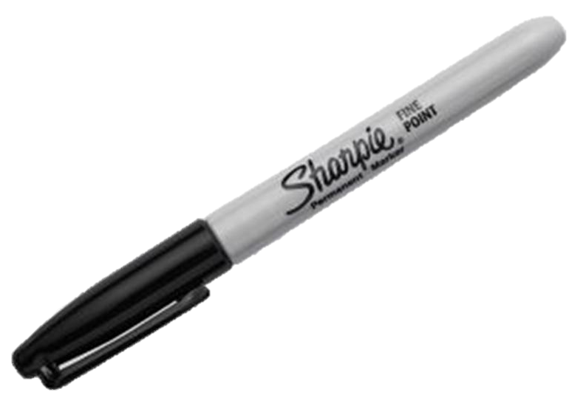
What else might you need?

Slide 12
See Elena Smyroniotis, Grant Wood Fellow, demonstrate how to make a bee from recycled materials
Build-a-Bee Example #1
Build-a-Bee Example #2
Another Example
Please don’t use paper products as they won’t survive outside
Build-a-Bee Example #3

Slide 13
Time to Install!
Watch for giant “beehives” to pop up at the Indian Creek Nature Center and the Czech Village/New Bohemia Main Street District in April. Then, take your bee to the “hive” and attach it with the zip ties provided.
Then, celebrate the importance of bees during
Earth Day, April 22, 2021!

Slide 14
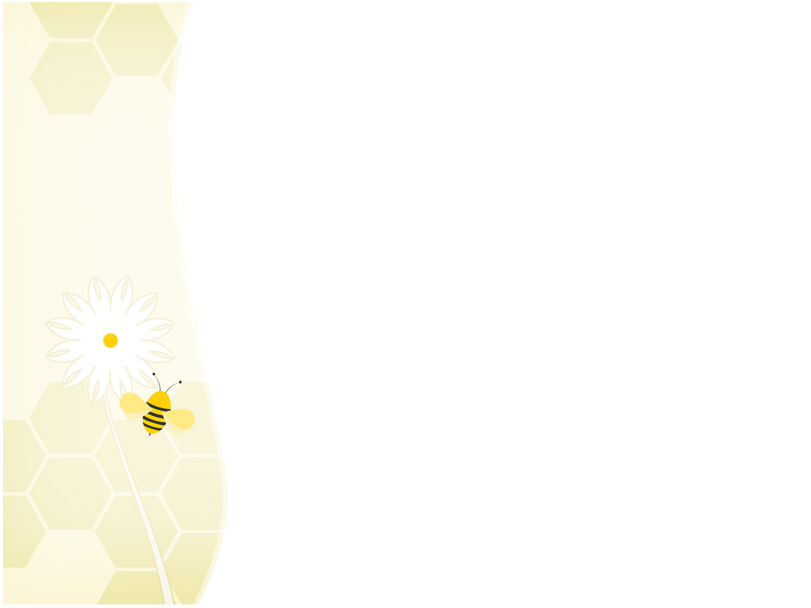

Remember…
To have fun and be creative!
Explore using any recycled materials you can find!

Slide 15




Thank you to our sponsors!

